Slide 1
CS 2413- 502 7-Mar-2017
C++ Concepts

Slide 2
Inheritance
New classes can be derived from existing classes using a mechanism called "inheritance”.
Classes that are used for derivation are called "base classes" of a particular derived class.
The base classes so named must have been declared previously.
The base specifications may contain an access specifier, to control the derived class's permission to use to members of the base class.

Slide 3
Single Inheritance
Derived classes have only one base class.

Slide 4
Example

Slide 5
Multiple Inheritance
A class can be derived from more than one base class.
Order of base class does not matter unless special cases of constructor and destructor.

Slide 6
Virtual Base classes
A way to save space and avoid ambiguities in class hierarchies that use multiple inheritance.
A virtual base acts as an indirect base more than once without duplication of its data members.
A single copy of virtual base’s data members is shared by all the base classes that use it as a virtual base.

Slide 7
Problem Illustration
The new class contains two subobjects of type Queue, one from CashierQueue and the other from LunchQueue.

Slide 8
Solution: virtual keyword
The virtual keyword ensures that only one copy of the subobject Queue is included.

Slide 9
Public Inheritance
When a class uses public member access specifier to derive from a base.
All public members of the base class are accessible as public members of the derived class
All protected members of the base class are accessible as protected members of the derived class.
Private members of the base are never accessible unless friended.

Slide 10
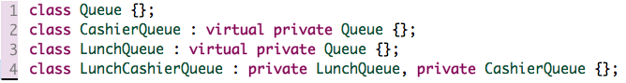
Private Inheritance
When a class uses private member access specifier to derive from a base.
All public and protected members of the base class are accessible as private members of the derived class
Private members of the base are never accessible unless friended.
Required to control polymorphism.

Slide 11
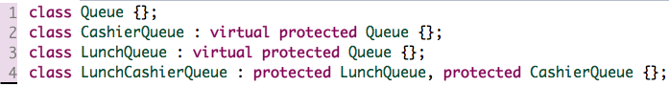
Protected Inheritance
When a class uses private member access specifier to derive from a base.
All public and protected members of the base class are accessible as protected members of the derived class.
Private members of the base are never accessible unless friended.
Protected inheritance may be used for "controlled polymorphism”.

Slide 12
Friend Class
Can access private and protected members of other class in which it is declared as friend.

Slide 13
Friend Function
A friend function can be given special grant to access private and protected members.
A friend function can be: a) A method of another class b) A global function

Slide 14
Key points on ”friend”
Friends should be used only for limited purpose. too many functions or external classes are declared as friends of a class with protected or private data, it lessens the value of encapsulation of separate classes in object-oriented programming.
Friendship is not mutual. If a class A is friend of B, then B doesn’t become friend of A automatically.
Friendship is not inherited.

Slide 15
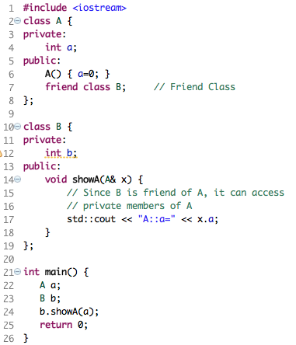
Example: “friend” class

Slide 16
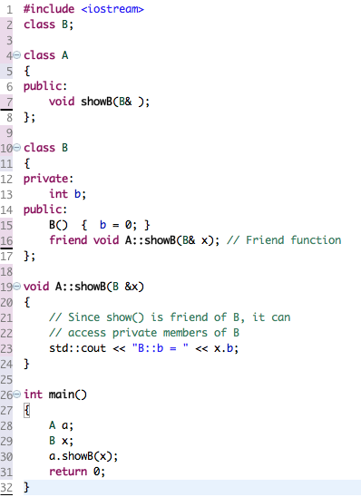
Example: “friend” function

Slide 17
Static Members
When a data member is declared as static, only one copy of the data is maintained for all objects of the class.
Static data members are not part of objects of a given class type.
The declaration of a static data member is not considered a definition.
The data member is declared in class scope, but definition is performed at file scope.
These static members have external linkage.

Slide 18
Example

Slide 19
Virtual Function
A member function, expected to be redefined in derived classes.
When a derived class’ object is referenced using a pointer or a reference to the base class, virtual function can be called for that object and execute the derived class's version of the function.
Virtual functions ensure that the correct function is called for an object, regardless of the expression used to make the function call.

Slide 20
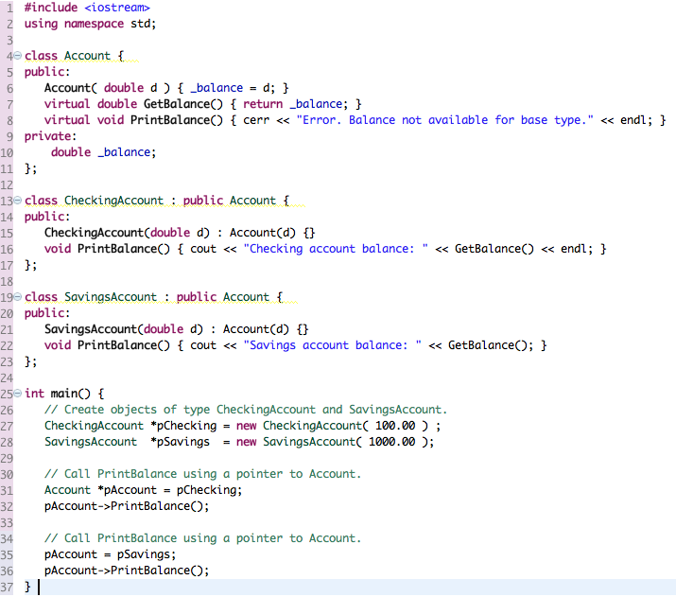

Example

Slide 21
Abstract Class
Abstract classes act as expressions of general concepts from which more specific classes can be derived.
Abstract classes can not be instantiated; however, you can use pointers and references to abstract class types.
A class that contains at least one pure virtual function is considered an abstract class.
Classes derived from the abstract class must implement the pure virtual function or they, too, are abstract classes.

Slide 22
Restrictions and Example
Can not be used for:
Variables or member data
Argument types
Function return types
Types of explicit conversions

Slide 23
”this” Pointer
Passed as a hidden argument to all non-static member function calls.
Available as a local variable within the body of all non-static functions.
A constant pointer that holds the memory address of the current object.
Not available in static member functions as static member functions can be called without any object (with class name).
Takes up space in memory.

Slide 24
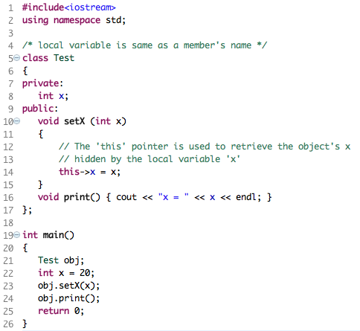
Case 1: When local variable’s name is same as member’s name

Slide 25
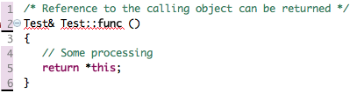
Case 2: To return reference to the calling object

Slide 26
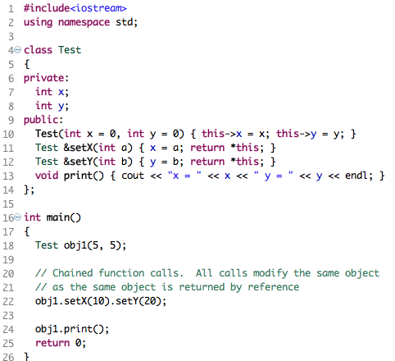
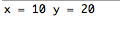
Case 3: Chain function calls on a single object.

Slide 27


Slide 28

THANK YOU!

